Slide 1


SRM VALLIAMMAI ENGINEERING COLLEGE
DEPARTMENT OF CYBER SECURITY
CY3641 – MINI PROJECT
Final Review
Secure Mobile Application Permission Analyzer using Natural Language Processing
PROJECT MEMBERS:
UNDER THE GUIDANCE OF:
1.142223128045 2.142223128048 | - SHUNMUGA PRIYA R - SRIMATHI V | Ms. M.RAGHAVI Assistant Professor - O.G

Slide 2
ABSTRACT:
      In this project, an App Permission Analyzer is developed to examine mobile application permissions and Terms & Conditions in order to identify potential privacy and security risks. Many users accept policies without understanding how their data is collected and shared. The system uses keyword-based and text analysis techniques to detect permission usage, data-sharing practices, and possible manipulation tactics, and presents the results in a simple, understandable form so users can make safer decisions before installing or using an application.
      KEYWORDS: App permission analysis, Terms and conditions analysis, Privacy policy analysis .
      TOOLS : Natural language processing, Regex

Slide 3
INTRODUCTION:
Exploring the challenges in understanding mobile app permissions and privacy policies.
Analyzing application Terms & Conditions to identify hidden data access and usage practices.
Detecting manipulative and misleading keywords related to user consent and data sharing.
Utilizing keyword extraction and simple NLP techniques for policy analysis.
Demonstrating an automated approach for identifying privacy risk in mobile applications.

Slide 4
OBJECTIVES:
To analyze application Terms & Conditions to detect permission-related disclosures.
To identify manipulative keywords and statements used to obtain user consent.
To classify privacy risks based on extracted keywords and policy content.
To generate a simple and understandable permission risk report for users.

Slide 5
SCOPE:
Automatic Analysis – The system automatically analyzes mobile application permissions and privacy policies to identify potential privacy risks.
User Privacy Awareness – It helps users understand how applications may collect, store, or share their personal data before installing them.
NLP-Based Policy Understanding – Uses Natural Language Processing techniques to simplify complex privacy policy texts and extract important information.

Slide 6
SCOPE:
Risk Identification – Highlights sensitive permissions and privacy-related issues that may affect user data security.
Future Expansion – The system can be extended to integrate with app stores, real-time permission monitoring, and advanced machine learning models for improved risk detection.

Slide 7
EXISTING SYSTEM:
Users install apps quickly without reading permissions or privacy policies.
Terms & Conditions are long and complex, so most users just click “Accept.”
App stores like Google Play Store only show permission lists but don’t explain privacy risks.
Security tools mainly detect malware and do not analyze privacy policies.

Slide 8
EXISTING SYSTEM:
Because of this, users don’t know how their data is collected or used.
Apps may share user data with third parties without users realizing it.
This creates privacy risks and hidden data collection problems.

Slide 9
LITERATURE SURVEY OF THE BASE PAPER:
S.NO | TITLE | AUTHORS | YEAR | METHODOLOGY | INFERENCE | MERITS | DEMERITS
1. | Automated Identification of security & privacy requirement from software engineering contracts | Preethu Rose Anish, Aparna verma, Sivanthy V., logamuruga v., smitha ghaisas | 2023 | Natural Language Processing Contract sentence extraction | Extracts privacy and security requirements automatically from software engineering contract documents using NLP; contracts treated as text source to find requirement sentences. | Automatic extraction Saves time Improves requirement detection | Complex legal language Accuracy may vary

Slide 10
LITERATURE SURVEY OF THE BASE PAPER:
S.NO | TITLE | AUTHORS | YEAR | METHODOLOGY | INFERENCE | MERITS | DEMERITS
2. | Intelligent Analysis of Android Application Privacy Policy and Permission Consistency | Y. Li, J. Zhang, and H. Chen | 2024 | Uses NLP and TextCNN to compare privacy policy statements with app permissions. | Finds mismatches between permissions requested and policy explanations. | Improves transparency and detects privacy risks | Requires large datasets and training for deep learning models.

Slide 11
LITERATURE SURVEY OF THE BASE PAPER:
S.NO | TITLE | AUTHORS | YEAR | METHODOLOGY | INFERENCE | MERITS | DEMERITS
3. | Static Analysis Framework for Permission-Based Dataset Generation and Android Malware Detection using Machine Learning | Amarjyoti Pathak, Th. Shanta Kumar, and Utpal Barman | 2024 | Uses machine learning and static analysis to study Android app permissions. | Permission patterns help identify malicious apps. | Improves detection accuracy and automates security analysis. | Cannot detect hidden runtime behavior.

Slide 12
LITERATURE SURVEY OF THE BASE PAPER:
S.NO | TITLE | AUTHORS | YEAR | METHODOLOGY | INFERENCE | MERITS | DEMERITS
4. | Research on Android User Privacy Permission Analysis and Protection Mechanism under Big Data Environment | Mei Liu and Qun Wang | 2024 | Analyzes Android permissions using big data techniques. | Proper permission management improves user privacy protection. | Enhances privacy protection strategies. | Requires additional system resources.

Slide 13
LITERATURE SURVEY OF THE BASE PAPER:
S.NO | TITLE | AUTHORS | YEAR | METHODOLOGY | INFERENCE | MERITS | DEMERITS
5. | Harnessing Language Models to Analyze Android App Permission Fidelity | Ritwik Banerjee, Ethan Myers, and Indrakshi Ray | 2025 | Uses large language models to analyze app descriptions and permissions. | Language models improve permission analysis accuracy. | Higher accuracy and better context understanding. | Needs high computational power and large datasets.

Slide 14
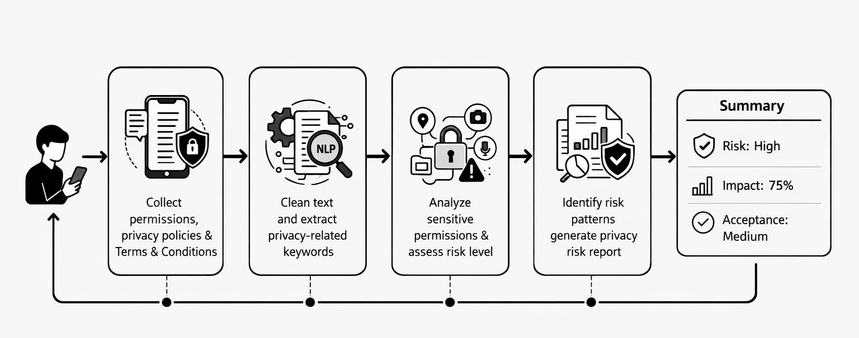
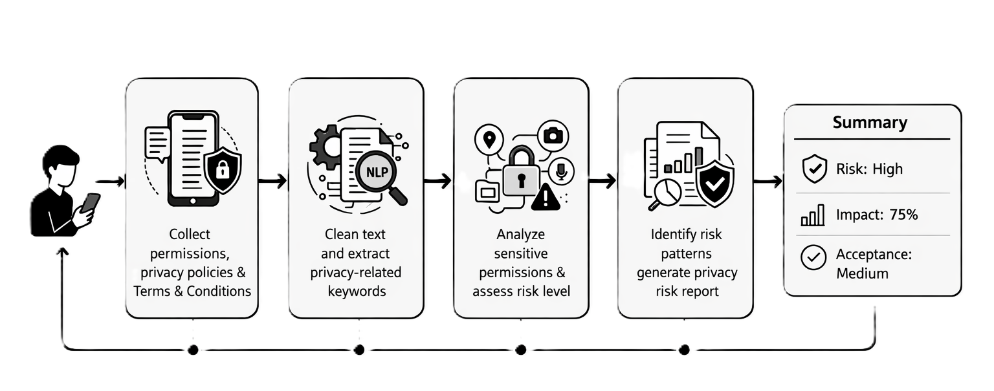
ARCHITECTURE DIAGRAM :

Slide 15
PROPOSED SYSTEM:
Proposed system: Secure Mobile Application Permission Analyzer using Natural Language Processing (NLP).
The system extracts text from Terms & Conditions and privacy policies.
It uses NLP to find keywords related to data collection, tracking, and data sharing.
The system analyzes sensitive permissions like location, contacts, camera, and microphone.

Slide 16
PROPOSED SYSTEM:
It compares permissions with statements in the privacy policy.
The system classifies apps into risk levels – Low, Medium, or High privacy risk.
It generates a simple report explaining the privacy risks to the user.
This helps users understand privacy issues before installing an app and improves security.

Slide 17
LIST OF MODULES :
Data Collection.
Text Processing.
Permission Analysis.
Risk Classification And Report Generation.

Slide 18
MODULE DESCRIPTION:
Module 1: Data Collection :
Collects mobile app permissions and privacy policy/terms text.
Extracts data from app files or store descriptions.
Module 2: Text Preprocessing ( NLP ) :
Cleans and processes privacy policy text.
Identifies keywords related to data collection, tracking, and sharing.

Slide 19
MODULE DESCRIPTION:
Module 3: Permission Analysis :
Analyzes sensitive permissions like location, camera, contacts, microphone.
Compares permissions with statements in the privacy policy.
Module 4: Risk Classification & Report Generation :
Classifies apps as Safe, Moderate Risk, or High Risk.
Generates a user-friendly report or warning about privacy risks.

Slide 20
MODULE 1: Permission, Privacy Policy and Terms & Conditions Collection
Collects privacy-related information from mobile applications.
Users can search an app by name or paste the privacy policy text .
The system retrieves app permissions, privacy policy, and terms & conditions.
Users can also manually paste policies using the Paste Policy option.
The collected data is stored and used for further analysis in later modules.
Helps identify privacy risks and sensitive permission usage.

Slide 21
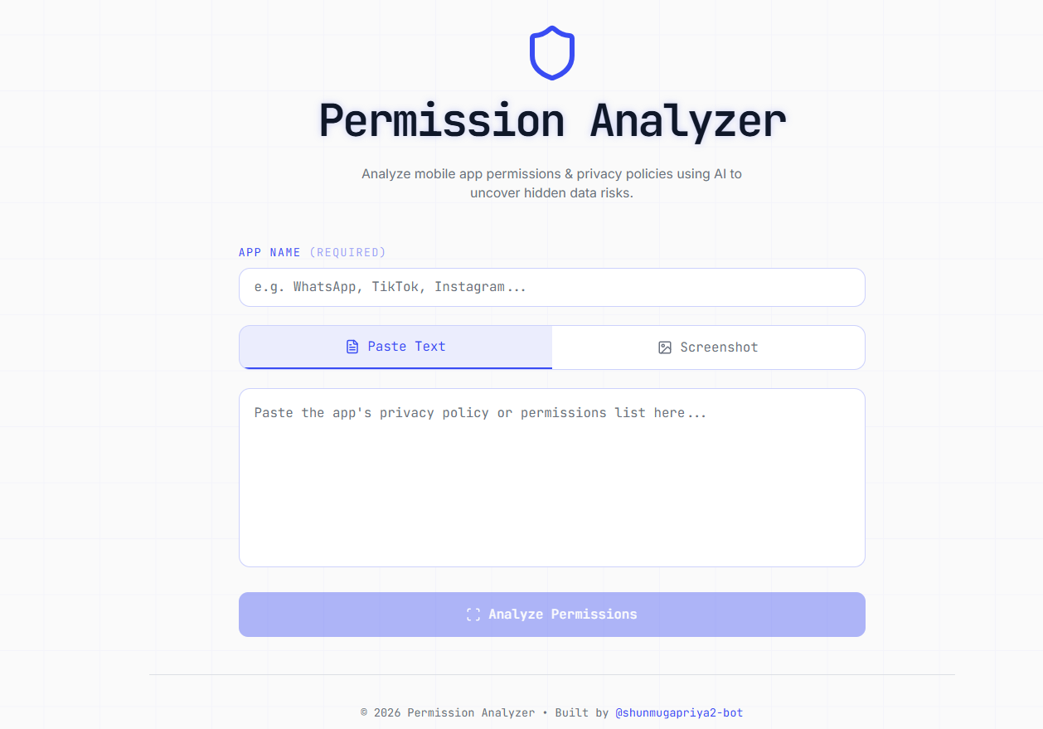
MODULE 1 : IMPLEMENTATION

Slide 22
MODULE 2: Extract Text & Privacy Related Policies
This module acts as a filter to remove "noise" and irrelevant text.
It uses NLP techniques to clean up spaces, symbols, and formatting.
The system checks if the text is actually a real privacy document.
It extracts important keywords related to data tracking and sharing.
It prevents the AI from wasting energy on junk or unrelated data.
It correctly identifies if the input is a "Policy" or a "Permission" list.

Slide 23
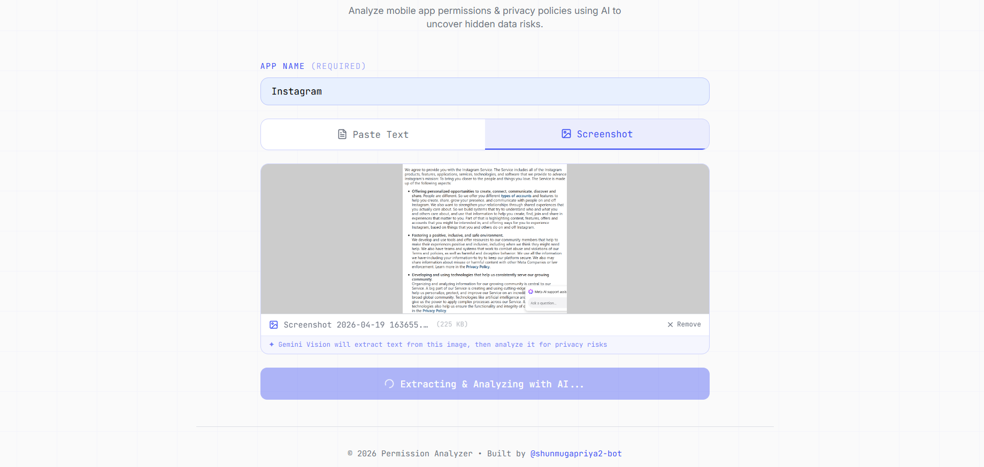
MODULE 2 : IMPLEMENTATION

Slide 24
MODULE 3 : Analyse Permissions & Risk Levels
This is the "Brain" of the project powered by AI.
It calculates a risk score based on how sensitive the requested data is.
The AI understands the context of why an app needs certain permissions.
It detects hidden risks that a simple keyword search would definitely miss.
It flags high-risk access requests like Microphone, Camera, or Contacts.
The module creates a smart explanation for every risk it identifies.

Slide 25
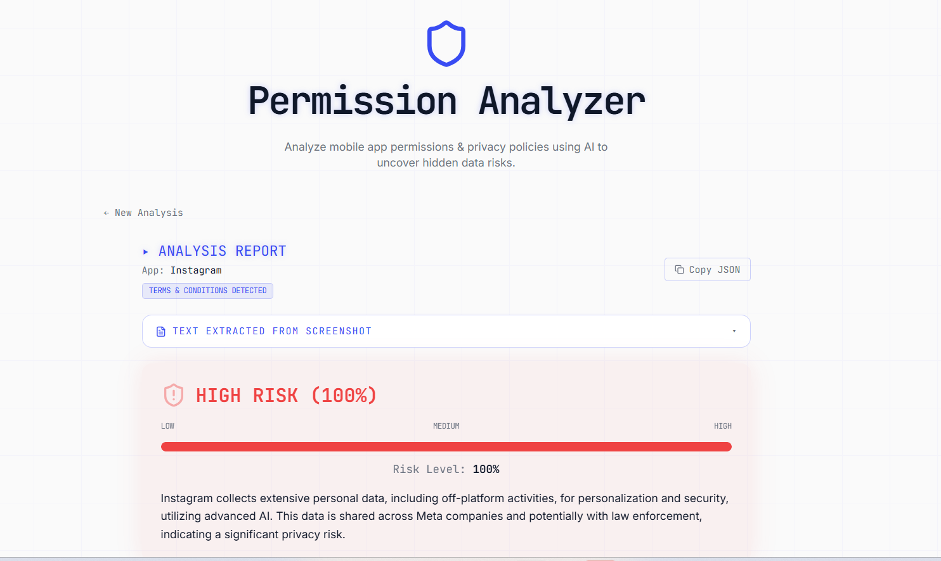
MODULE 3 : IMPLEMENTATION

Slide 26
MODULE 4 :Identify Risk Patterns & Generation Report
It takes complex AI data and turns it into a visual dashboard.
It displays a color-coded Risk Meter for quick visual understanding.
The module generates bar charts to show a summary of all identified risks.
It provides a list of actionable steps to help the user stay safe.
It gives a final "Acceptance Level" (High, Medium, or Low) for the app.
Designed to make the final report clear and easy for non-technical users.

Slide 27
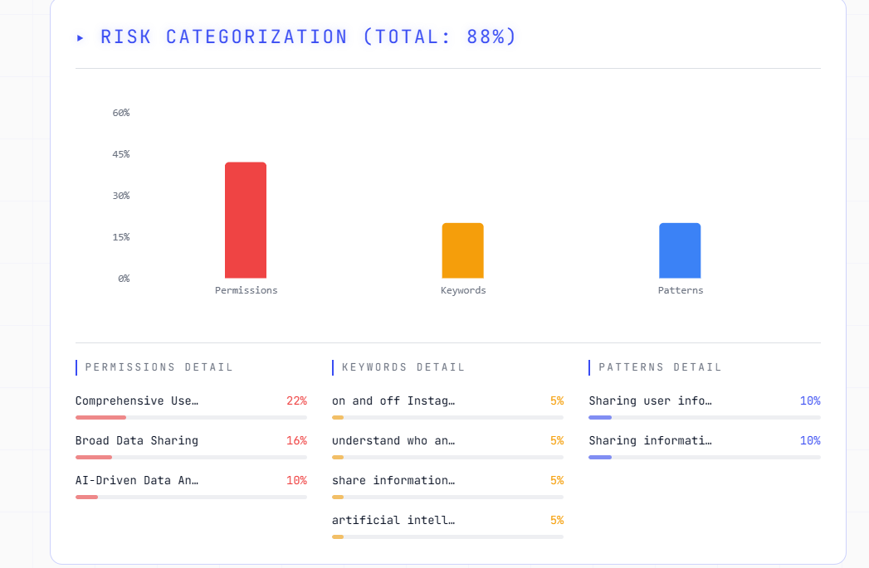
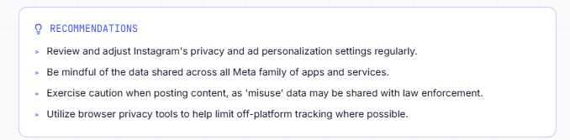
MODULE 4 : IMPLEMENTATION

Slide 28
REFERENCES:
A. Raga, M. Mannan and A. Youssef,“Trust Me Over My Privacy Policy: Privacy Discrepancies in Romantic AI Chatbot Apps,” in Proceedings of the 2024 IEEE European Symposium on Security and Privacy Workshops (EuroS&PW), 2024.
S. Wang, Y. Wang and X. Zhan,“APER: Evolution-Aware Runtime Permission Misuse Detection for Android Apps,” in Proceedings of the 44th IEEE/ACM International Conference on Software Engineering (ICSE), 2022.
M. Duan, L. Jiang, L. Xin Shan and D. Gao,“UIPDroid: Unrooted Dynamic Monitor of Android App UIs for Fine-Grained Permission Control,” in Proceedings of the 44th IEEE/ACM International Conference on Software Engineering: Companion Proceedings (ICSE-Companion), 2022.

Slide 29
REFERENCES:
N. Kowsika, U. Uma Maheswari and R. Vathan Arun Sathya,“Identifying Fake Apps on Google Play Store Through Text Analysis: Leveraging Natural Language Processing for App Safety,” in Proceedings of the 8th International Conference on Computing Methodologies and Communication (ICCMC), IEEE, 2025.
P. R. Anish, A. Verma, S. V., L. V. and S. Ghaisas,“Automated Identification of Security & Privacy Requirements from Software Engineering Contracts,” in IEEE International Requirements Engineering Conference Workshops, 2023.

